Slide 1
DATA STORY TELLING
BY
HABIBU ABDULLAHI
3MTT FELLOW
FE/23/30296093

Slide 2
INTRODUCTION
This project understands how the student’s performance (test scores) is affected by other variables such as Gender, Ethnicity, Parental level of Education , Lunch and Test preparation course.

Slide 3
AIMS AND OBJECTIVES
To understand the influence of the parent's background, test preparation etc. on students’ performance.

Slide 4
METHODOLOGY
The dataset used in this work is gotten from “KAGGLE” which is an online data base.

Slide 5
KEY QUESTIONS
Which gender has the highest average?
Which among the classes of groups has the best performance?
Which gender in each classes performs best in the test?

Slide 6
FINDINGS AND INSIGHTS

Slide 7
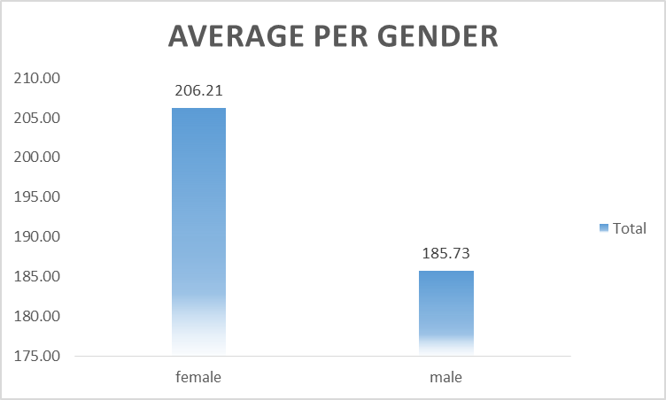
Which gender has the highest average?
From the analysis presented, it shows that female students have the highest average, which means that the total marks of the females is high than that of male students.

Slide 8
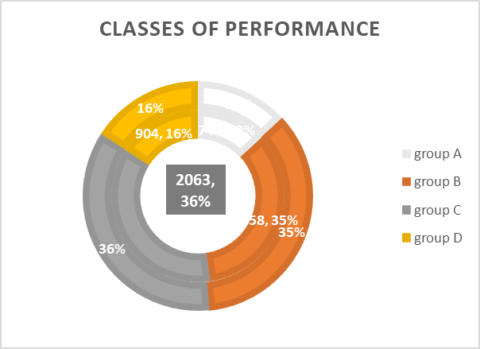
Which among the classes of groups has the best performance?
Every group has a combination of male and female and with the contribution each gender gives in their respective class, group C scores the highest percentage because they have highest reading score. Followed by group B, C then A.

Slide 9
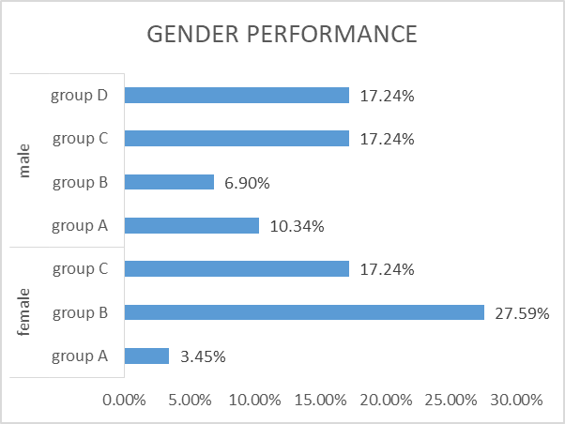
Which gender in each classes performs best in the test?
In this analysis, we can identify that there is no any female student in group D which gives the male students a chance to defeat their counter gender with 51.72% and leaving the female with 48.28% as shown in the chart.

Slide 10
RECOMMENDATION
In recommendation, male students has the lowest marks as shown in the average performance as such, the male students need to be engaged with more reading activities and extra curriculum that will encourage them to develop a good reading habit.

Slide 11
CONCLUSION
In conclusion, male performance is lower than that of female despite the lack of female participation in group D. Therefore, female are the best student as the conclusion drawn from the average presented in the first chart.

